Slide 1



SMART BATTERY SAFETY DIAGNOSTIC SYSTEM
ANRF MAHA-EV project
Enphase Solar Energy Pvt. Ltd logo ?

Slide 2
Team
Prof. Pallavi Bharadwaj, PI
Dr Sanjeev Patil, Project Manager
Dr Ashish Prajapati, Project Scientist-II
Dr. Sirsa Aditya, Project Scientist-I
Samsaptak Ghosh, Project Scientist-I
Shiv Shankar Sinha PhD Student
Yash Nileshkumar Desai MTech Student
Ambika Biswas Neela PhD Student
Arpita Sarcar PhD Student
Harsh Kumar PhD Student
Resources:
https://labs.iitgn.ac.in/spel/staff.html
https://labs.iitgn.ac.in/spel/principal%20investigator.html

Slide 3
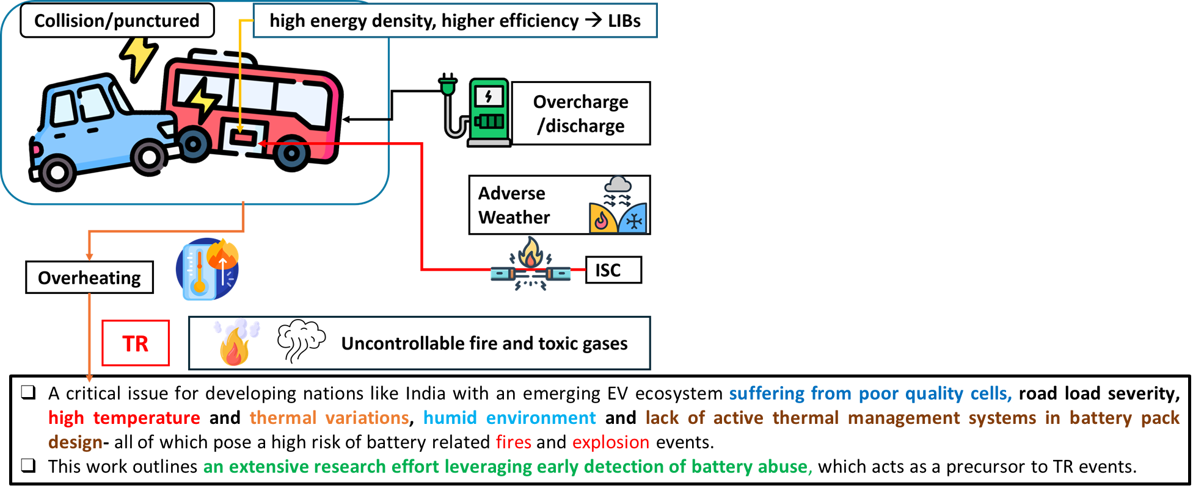
Objectives
Electrothermal abuse (ETA) test setup under development for battery-abuse data collection:
Battery Digital Twin based Adaptive RL:
Anomaly Detection using Deep Learning:

Slide 4
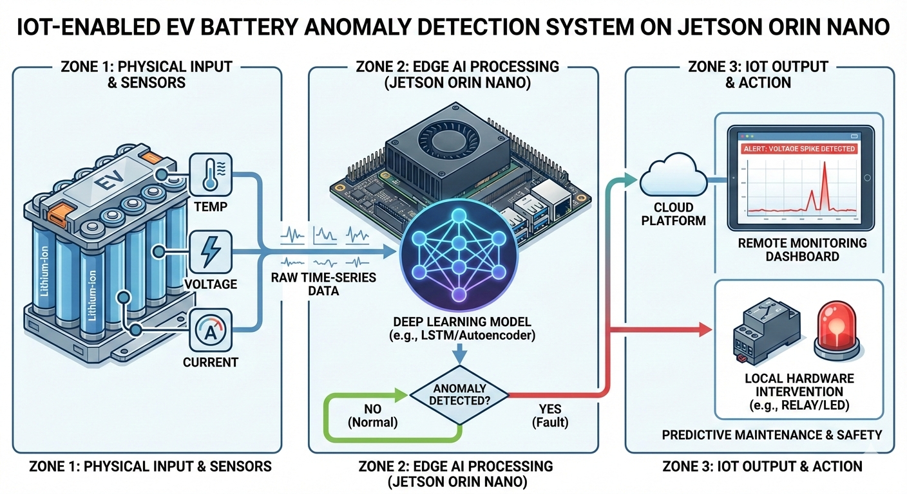
Objectives
Anomaly Detection using Deep Learning:

Slide 5
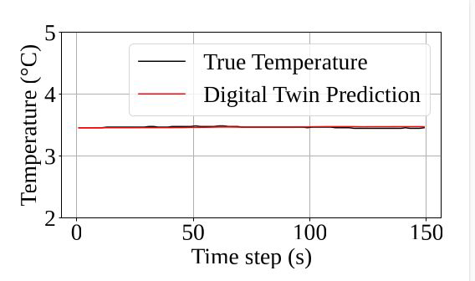
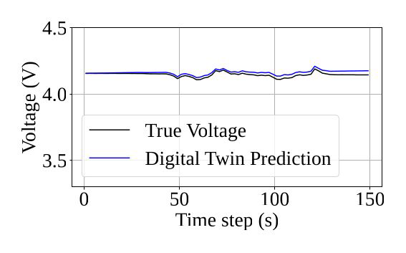
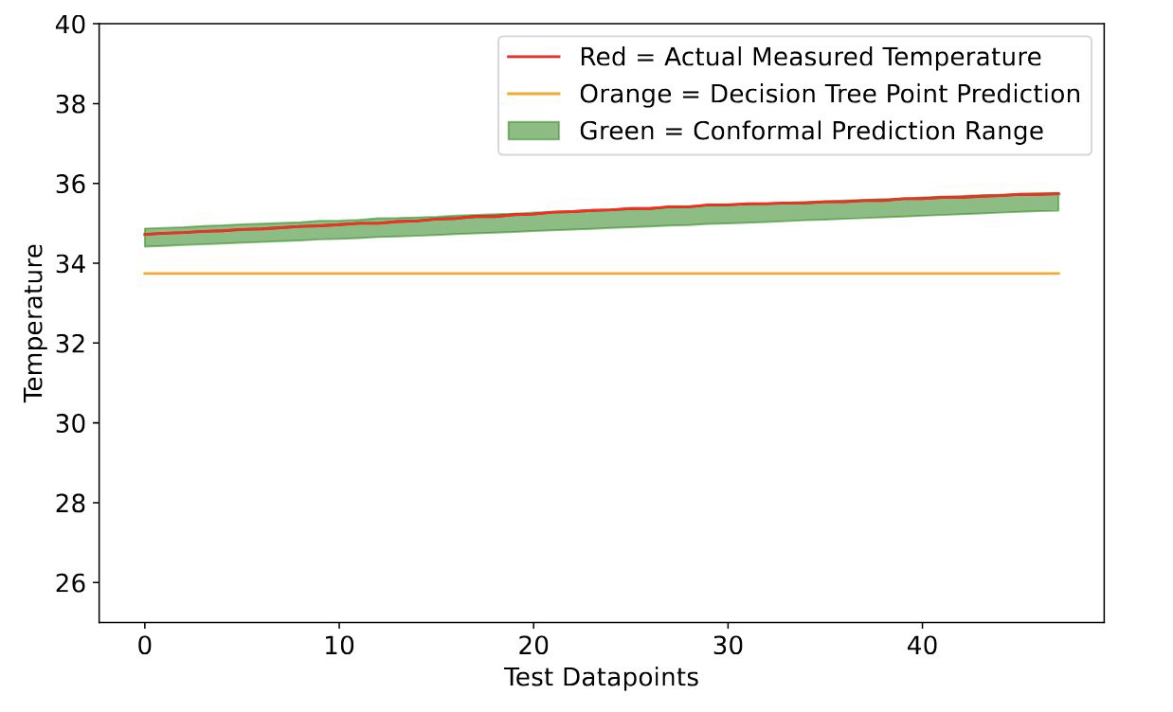
Objectives
Battery Digital Twin based Adaptive RL:
Mean Absolute Error: 0.012 ℃
Mean Absolute % Error: 0.39%
Uncertainty aware temperature prediction

Slide 6
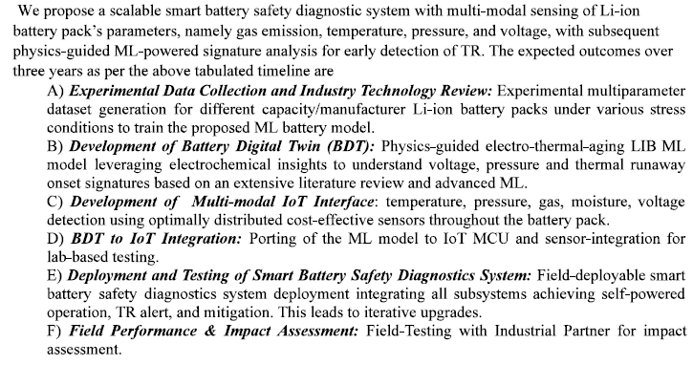
Deliverables

Slide 7
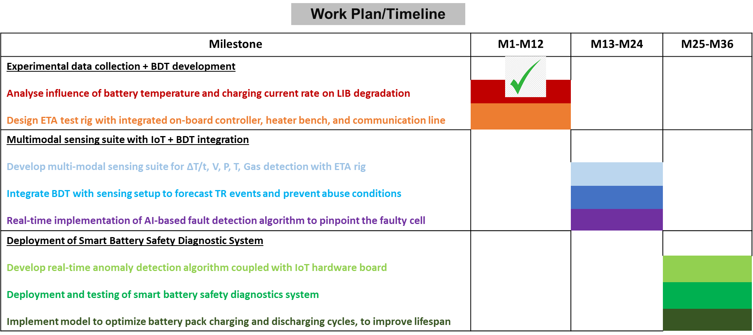
Milestones & Timeline

Slide 8
Output
Journal publications:
S. S. Sinha, B. Lehman and P. Bharadwaj, "Life Extension of Lithium-Ion Battery: Degradation Comprehension, Modeling, Characterization, and Mitigation Strategies," IEEE Open Journal of Power Electronics, vol. 7, pp. 1-27, 2026, doi: 10.1109/OJPEL.2025.3639205.
Conferences:
Y. Desai, S. Ghosh, and P. Bharadwaj, "Predicting Mechanically Induced Thermal Runaway Severity in Multi-Chemistry Lithium-Ion Cells Using LightGBM for Battery Safety Applications", IEEE 12th National Power Electronics Conference (NPEC 2025), NIT Calicut, December 14–16, 2025. Best Paper Award
Patents:
Upcoming

